Slide 1
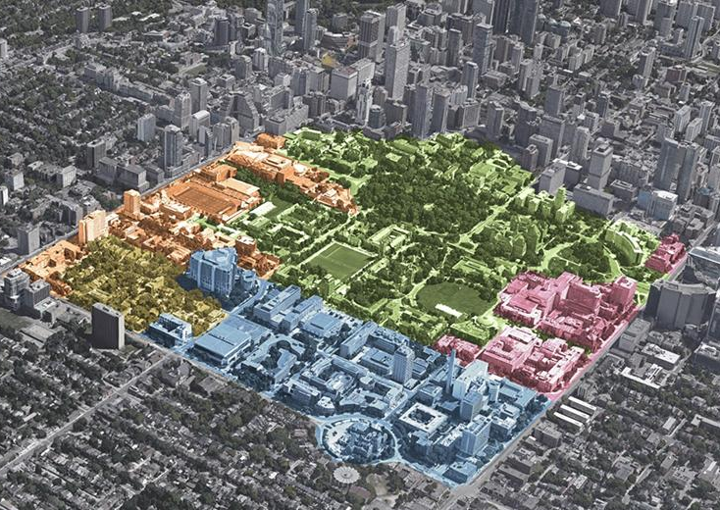

Combining Forces: fostering university/city partnerships
Presentation at City Deal on Education conference,
Breda, The Netherlands
John Robinson
University of Toronto
Jun 3 2022

Slide 2
Two topics I want to touch on
Generation of actionable knowledge
  – transdisciplinary knowledge co-production
Some ongoing activities at the University of Toronto
  –living lab projects and Urban Climate Action Project (UCAP)

Slide 3
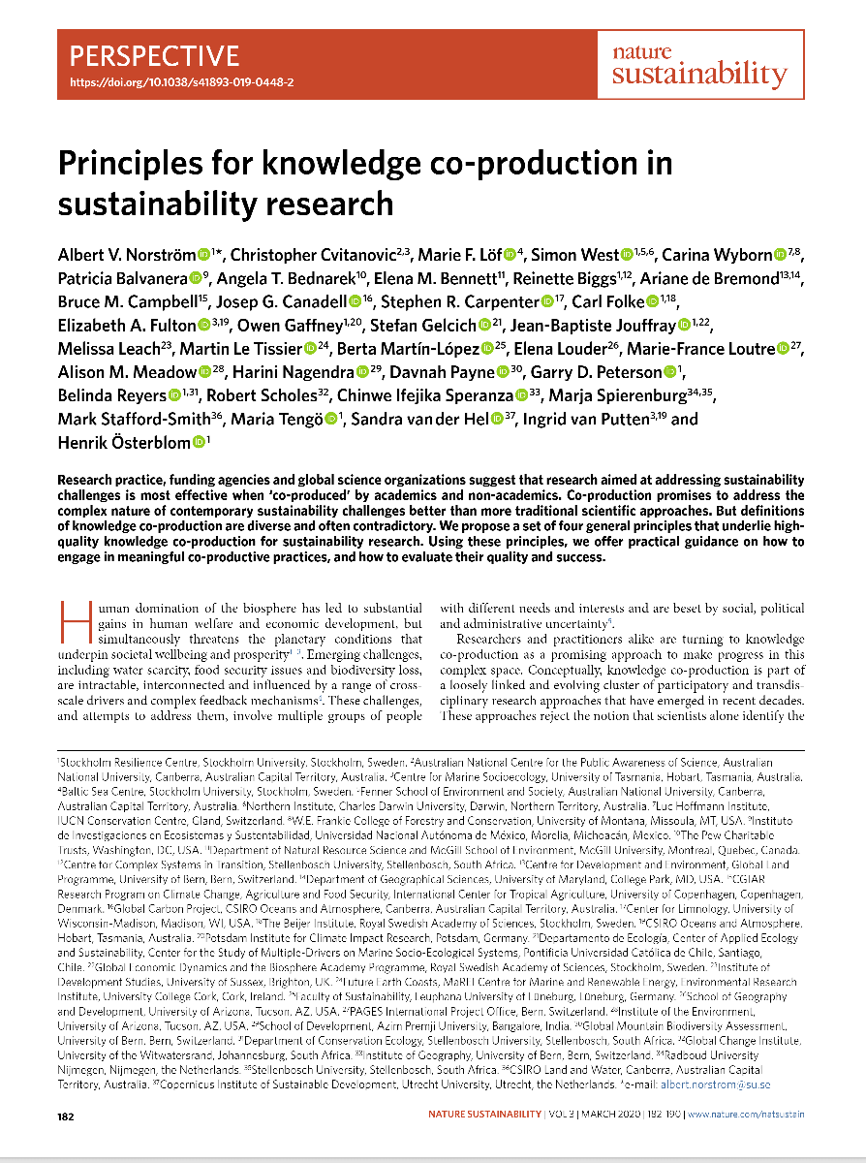
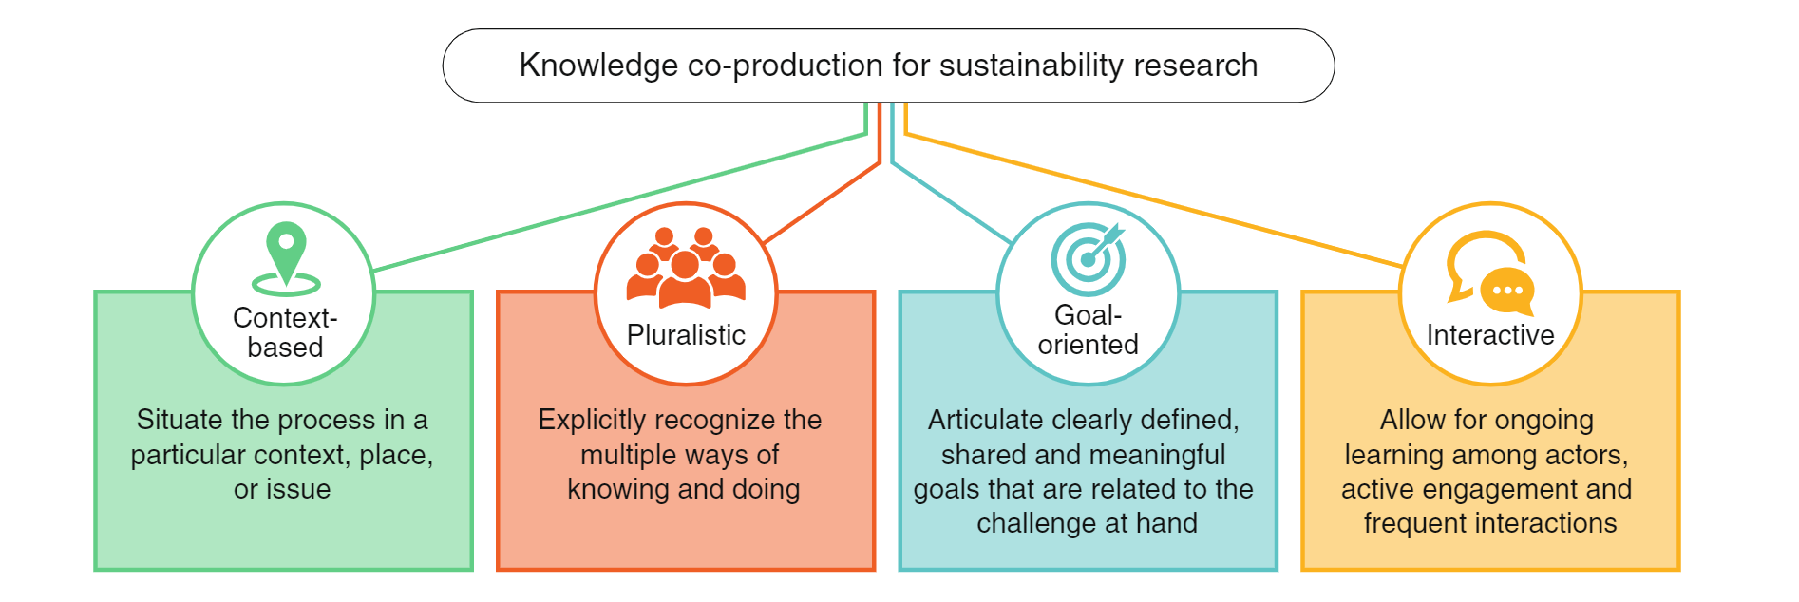
1. Generation of Actionable Knowledge
Knowledge co-production for sustainability research
“we define knowledge co-production as ‘iterative and collaborative processes involving diverse types of expertise, knowledge and actors to produce context-specific knowledge and pathways towards a sustainable future’”
(aka. transdisciplinary research)
Norström, A. et al (2020). Principles for knowledge co-production in sustainability research. Nature Sustainability, 3(3), 182-190

Slide 4
Transdisciplinary Knowledge Co-Production
1. Generation of Actionable Knowledge
Generation of Actionable Knowledge
Various “co’s”
  Co-creation of partnerships
    Must work for both sides
  Co-production of knowledge
    All partners are involved in development of research questions and interpretation of results
  Co-design of projects and Co-management of work
    All partners involved in research design, and research process
  Co-implementation of results
    Multiple fora of application
All give rise to emergent properties and understandings
Not all research falls into these categories: lots of room and need for conventional research in transdisciplinary projects
But such conventional work should connect to larger transdisciplinary agenda: ultimate goal is actionable knowledge

Slide 5
From more extractive to more reciprocal approaches to research
1. Generation of Actionable Knowledge
More extractive | More reciprocal
World as source of data | World as partner
Primary audience is academic | Multiple non-academic audiences
Primary products are academic | Multiple non-academic products
Researcher-driven RQs and methods | Co-design of research
Interactive Research:
  - takes more time
  - involves production of many non-academic outputs
  - leads to more interdisciplinary publications
So is high risk, especially for grad students and junior faculty
We are not trained in this

Slide 6
Key characteristics of societally-focussed transdisciplinary research
1. Generation of Actionable Knowledge
A. Problem-focused
B. Integrated (highly interdisciplinary)
C. Interactive (and emergent)
D. Reflexive
Problem-driven interdisciplinary research
E. Involves strong forms of collaboration with non-academic partners
The transdisciplinary addition
Based on: Robinson, J. (2008) “Being Undisciplined: Some Transgressions and Intersection in Academia and Beyond”, Futures, 40(1): 70-86

Slide 7
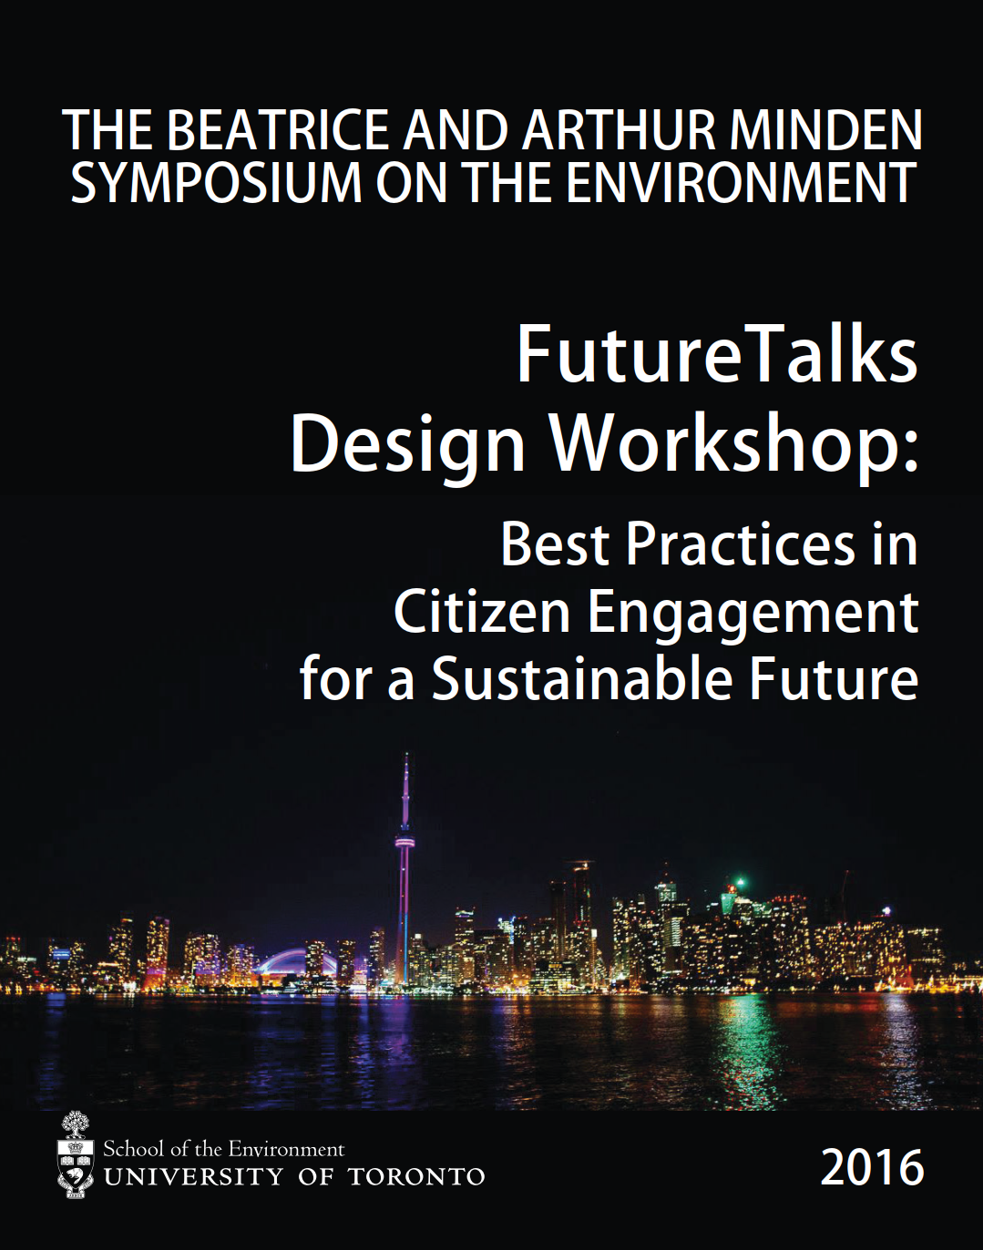
Lessons from our experiences in Toronto so far
1. Generation of Actionable Knowledge
Generation of Actionable Knowledge
There are many Toronto’s
  There is a need for diverse and tailored engagement strategies
Link climate change and sustainability issues to people’s everyday experiences
  The more personal, local, concrete, and relevant the issues on the table are, the more likely people will want to engage
Focus explicitly on outcomes
  Engagement processes are likely to be more effective if participants sense that their involvement will lead to change or a policy decision of some kind
Recognize barriers to community engagement
  Meaningful engagement processes demand resources (both time and money)
Work with and through trusted intermediaries
  They have access to multiple communities
Recognize the already existing agendas of all partners
  This works against the ‘extractive’ tendencies of traditional academic research
Partnering for Impact
2019

Slide 8
Some practical approaches for civil society partnerships
1. Generation of Actionable Knowledge
Generation of Actionable Knowledge
Principles: no net increase; mutual benefit
Piggybacking
Both ‘enhance the project’ and ‘build the community’
Governance
  Steering Committee and Partner Network
  Community Outreach and Training Coordinator
  Advisory Panel on the Engagement of Equity-Deserving Groups
Budget
  Funding for partner engagement and capacity-building commitments

Slide 9
Be clear about consequences of this approach to research
1. Generation of Actionable Knowledge
Generation of Actionable Knowledge
Productive partnerships take significant time to develop
A ‘real’ co-production approach has major challenges for academics
  Loss of control over overall research agenda and process (culture problem)
  Limitations of conventional reward system (promotion and tenure) within university
  Disconnect between academic and partner timelines
  Academic funding programs: whose criteria count?
But huge benefits
  Much stronger relationships with partners
  Access to partner knowledge and expertise
  Opportunity to test theory and concepts from literature
  Opportunity to contribute to actual change processes

Slide 10

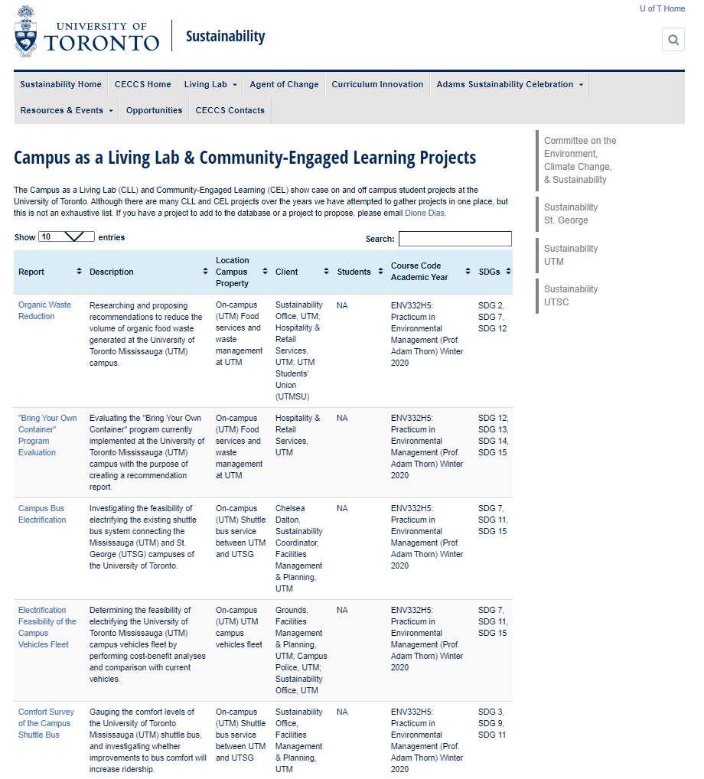
GLA2029 – Sustainability in the World: A Living Lab course (Winter, 2022)
2. Some U of T Examples
Teaching and Learning
56 1st year Munk School Master’s students
12 projects for City of Toronto and The Atmospheric Fund
  Projects came from practitioner side
  All focussed on TransformTO: Toronto’s climate plan
  14 City & TAF staff ‘clients’: Met weekly with 12 student groups
12 projects now on CLL/CEL student project database
  searchable, coded to SDGs, downloadable, 289 projects and counting
https://sustainability.utoronto.ca/home/ceccs/campus-as-a-living-lab/campus-as-a-living-lab-projects/

Slide 11

Urban Climate Action Project (UCAP)
2. Some U of T Examples
Actionable Knowledge
Campus as a living lab
Urban transition labs
Evaluations of programs and processes
Databases and models
Analysis of transition processes
Student internships with city
Community engagement research
Convening function (events, activities, meetings, etc.)
Network learnings and jurisdictional scans
Many cities have adopted climate targets that will require “transformational changes in how we live, work, commute and build” (City of Toronto, 2020)
Create a city-university collaborative
Focus on contributing actionable knowledge to help the City of Toronto achieve it TransformTO climate action goals and targets
Toronto node of UCAN network:
PROJECT: UC3 Cities Climate Action Network (UCAN)
CHAMPIONS: University of Arizona, University of British Columbia, Drexel U, University of Toronto

Slide 12
2. Some U of T Examples
3. Scaling Up
Five Focus Areas & Activities
FOCUS AREAS | RESEARCH | ENGAGE & CONVENE | INNOVATE & EXPERIMENT | EVALUATE | BUILD CAPACITY
Urban Living Lab Activities | R1: develop collaborative interdisciplinary research R2: identify best practices around the world R3: scan of relevant local and global trends R4: scan funding mechanisms | EC1: Convene partner events and activities EC2: Share operational practices EC3: Jointly develop community engagement programs EC4: Grow and strengthen strategic partnerships | IET1: Turn campuses into living laboratories and testbeds IET2: Set up urban transitions labs in city neighbourhoods, IE3: Jointly develop databases and models. IE4: Share new approaches for problem solving (e.g., multi-solving) | E1: Evaluate city programs and processes. E2: Embody and enhance reflexive practice to create new knowledge and mindsets | BC1: Engage graduate and undergraduate students internships and RAs. BC2: Help to grow the UCAN network.

Slide 13
General Lessons
Generation of actionable knowledge
  - transdisciplinary knowledge co-production offers great rewards but also great challenges for university/city partnerships
  importance of:
    co-design of research questions
    providing support for researchers
From examples
  - power of living lab approach
  - important role for universities in supporting sustainability transitions

Slide 14
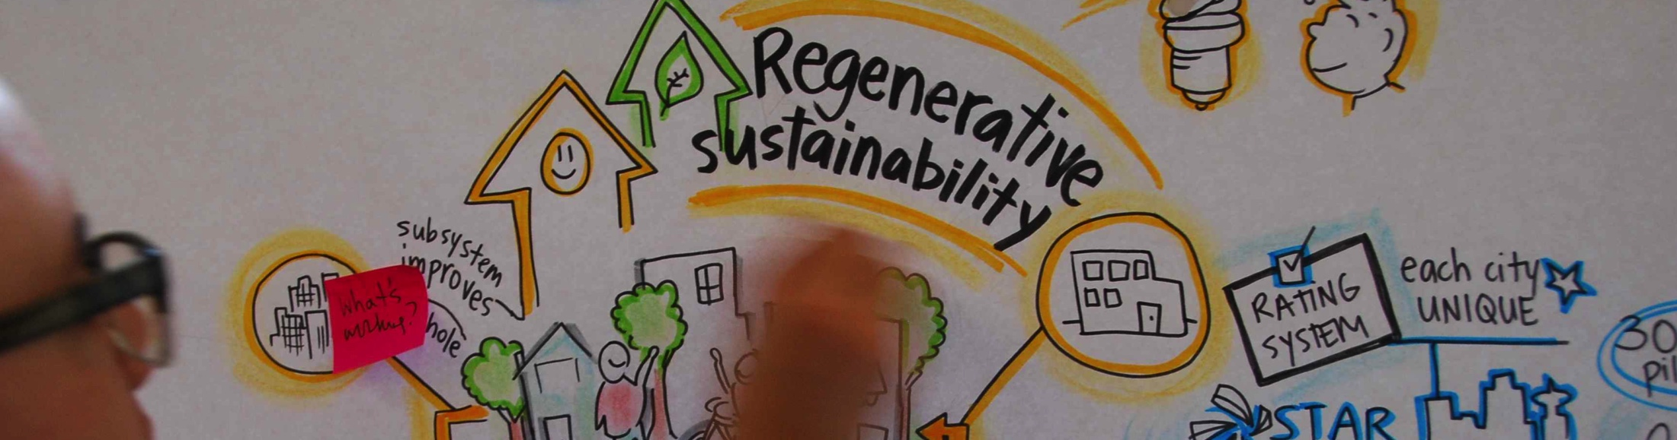
Let’s Make it Happen!

