Slide 1

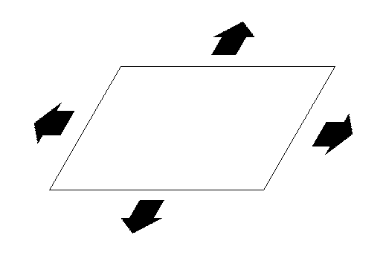

Pyramids, planes and scaling up: some thoughts on the institutionalization of sustainability in a university context
Presentation at City Deal on Education conference,
Breda, The Netherlands
John Robinson
University of Toronto
Jun 3 2022
RESEARCH | ENGAGE & CONVENE | INNOVATE & EXPERIMENT | EVALUATE | BUILD CAPACITY

Slide 2
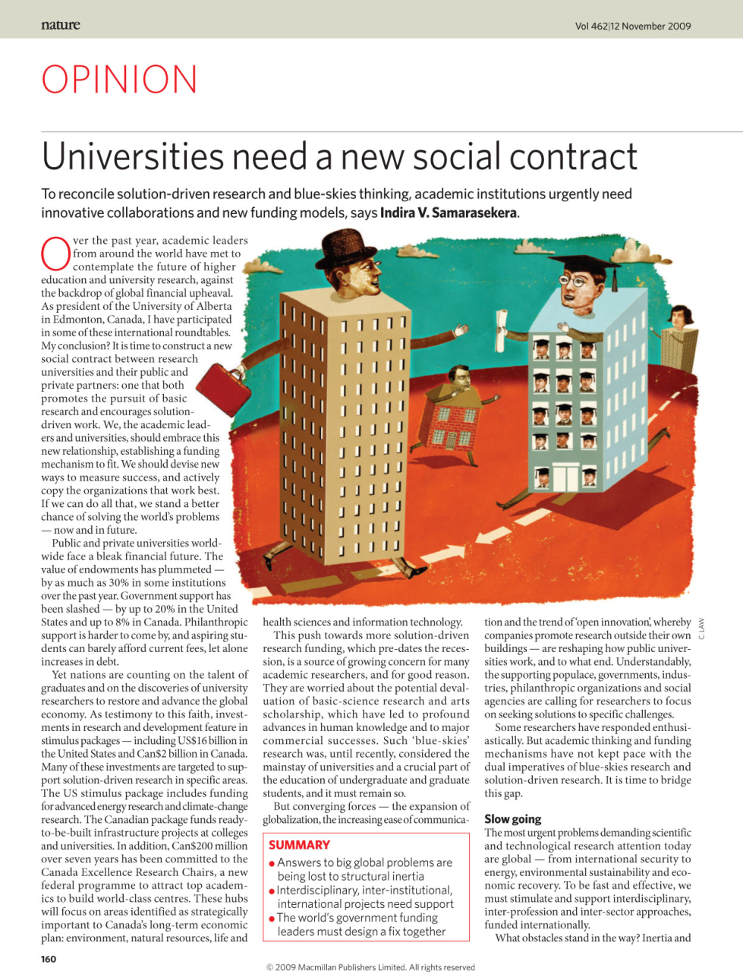
A New Social Contract?
“It is time to construct a new social contract between research universities and tier public and private partners; one that both promotes the pursuit of basic research and encourages solution–driven work.”
(Samarasekara, 2009 in Nature)
This has also been called the “Third Mission” of universities.
(e.g. Pinheiro et al, 2015)
Notes:
Pinheiro, R., Langa, P. V., & Pausits, A. (2015). The institutionalization of universities’ third mission: introduction to the special issue. European Journal of Higher Education, 5(3), 227-232.

Slide 3

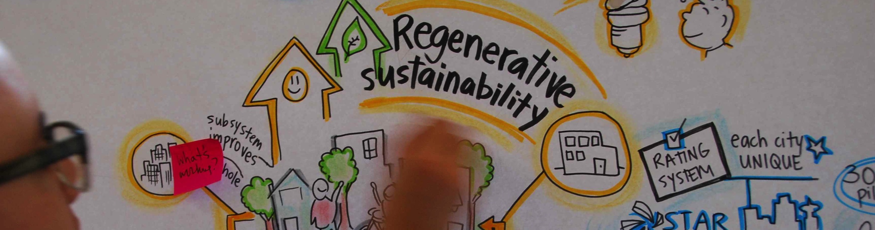

Regenerative Sustainability
Simultaneously increase human
and environmental wellbeing

Slide 4
Outline
Institutional culture change
The pyramid and the plane; strategies for creating change
Infusion of sustainability action into higher education
enabling and institutional embedding
Scaling up
scale-inflected theory of change, and role of university

Slide 5
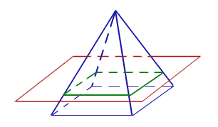
Institutional Culture Change: the pyramid and the plane
1. Institutional culture change
Academic
Academic
“The Plane”
Operational
“The Pyramid”
Operational

Slide 6











Towards a whole institution approach to sustainability
1. Institutional culture change

Slide 7
1. Institutional culture change
A Whole Institution Approach to Sustainability Governance Distributed Agency (DA) vs. Central Coordination (CC) in 10 universities
“The Plane”
“The Pyramid”
Academic Sustainability Governance | Operational Sustainability Governance
Culture is inherently DA, with CC providing support | Culture is primarily CC, with supporting DA components
Independence in research and teaching, ‘republic of scholars’ | Results-oriented, directives from upper management
Departments can influence, administrations not so much | Administrations direct sustainability work
Buy-in is voluntary; incentives needed | Buy-in in mandated; no incentives needed
Need CC for institutional engagement | Need DA for academic engagement (e.g. living lab)

Slide 8
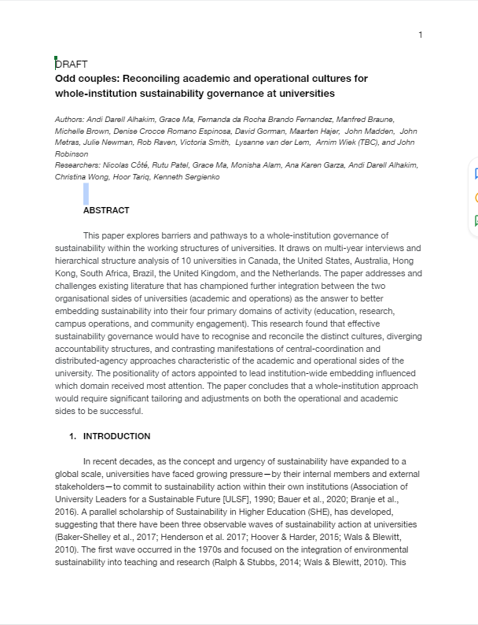
Reconciling Distributed Agency with Central Coordination
1. Institutional culture change
A whole institution approach must be tailored to differences in cultures, in accountability structures, and in the manifestation and importance of CC and DA governance models
Must speak to agendas on both sides
Need flexible and adaptable governance structures
Students as crucial intermediaries
5 principles:
Enabling role
Collective and inclusive narrative
Integration of operational and academic
Leveraging CE for TD research
Embed sustainability across curriculum

Slide 9





1. Institutional culture change
Implementation Challenges and Responses
Path Dependence (“Needle in the groove”)
→ perseverance; visibility; multi-level approach
Coordination (“Plate spinning”)
→ build bridges; frequent visits; connect to agendas
Momentum (“Brick laying”)
→ Constant forward progress; updates; follow-up
Partnerships &Team-building (“Mosaic ”)
→ Joint goals; ‘no net increase’; ‘mutual benefit’]
The Role of the University (“Wall flower”)
→ cross-cutting projects; living labs; agent of change

Slide 10
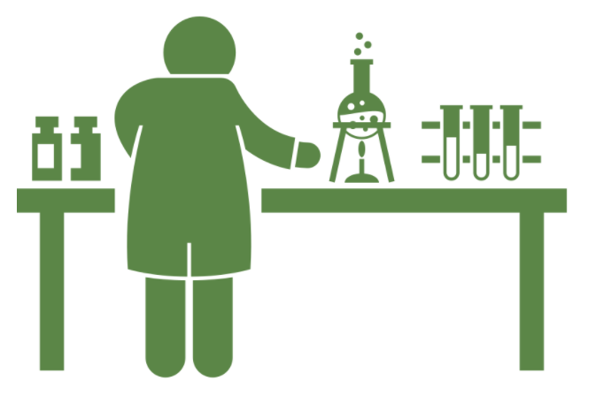

Two more (with thanks to Fiona Miller)
1. Institutional culture change
6. Protected niche
7. Catching waves
Reflects the need for experimentation, to identify and test new practices
What new practices need a protected niche for experimentation?
Reflects the constancy of change; we are not starting but steering
What existing reforms can you leverage (or tilt) to make this change?
10
10

Slide 11
What we have learned
1. Institutional culture change
Institutional issues are as important as substantive ones: need to change the rules of the game
Hold needle up; spin plates; lay bricks; create mosaics; join the dance; experiment; and catch the wave: the common thread is continuous engagement
Is a big latent demand for change and sustainability in organizations: key is to find ways forward that work for various partners
Is very important to enable others, not control, manage or direct
Success is when sustainability is normalized throughout the institution: it becomes the default not the change

Slide 12



2. Infusing sustainability in HE
President's Advisory Committee on the Environment, Climate Change, and Sustainability (CECCS)
Goals (whole institution approach; enabling role):
Sustainability a key component of U of T identity: whole institution approach
Local and international leadership in sustainability; and
Recognition, sharing and aggregation of good sustainability practices across the university.
Four Cross-cutting Themes (apply to all activities):
Campus as Living Lab
Student Engagement
University as Agent of Change
SDGs

Slide 13




2. Infusing sustainability in HE
CECCS Subcommittees
Inventories
ESE work
Inventories
ESE work
Sustainability Pathways
Pathways
Certificate Implementation
Pathways
Certificate Implementation
Teaching and Learning
Research
Climate Positive Campus
Engagement & Partnerships
Operations

Slide 14

Sustainability Pathways Framework
2. Infusion of Climate Action into HE
Teaching and Learning
Sustainability Citizen (acknowledgement of sustainability-related co-curricular activities, recorded on Student Co-Curricular Record (CCR)
Sustainability Scholar (sustainability curricular pathways certificate or minor, recorded on transcript)
Sustainability Leader (Citizen + Scholar + designated capstone or community-engaged learning course)
Will be offered to all undergraduate students at the university (not mandatory)

Slide 15
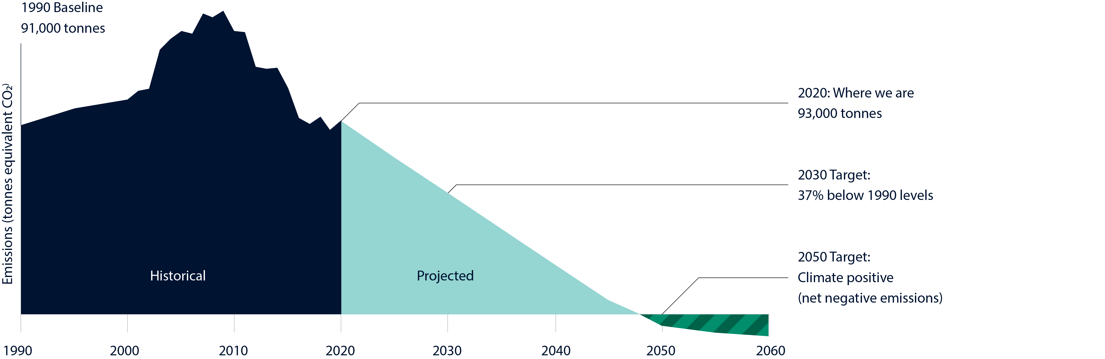
2. Infusing sustainability in HE
“The University of Toronto St. George Campus will become climate positive by 2050”
Operations

Slide 16

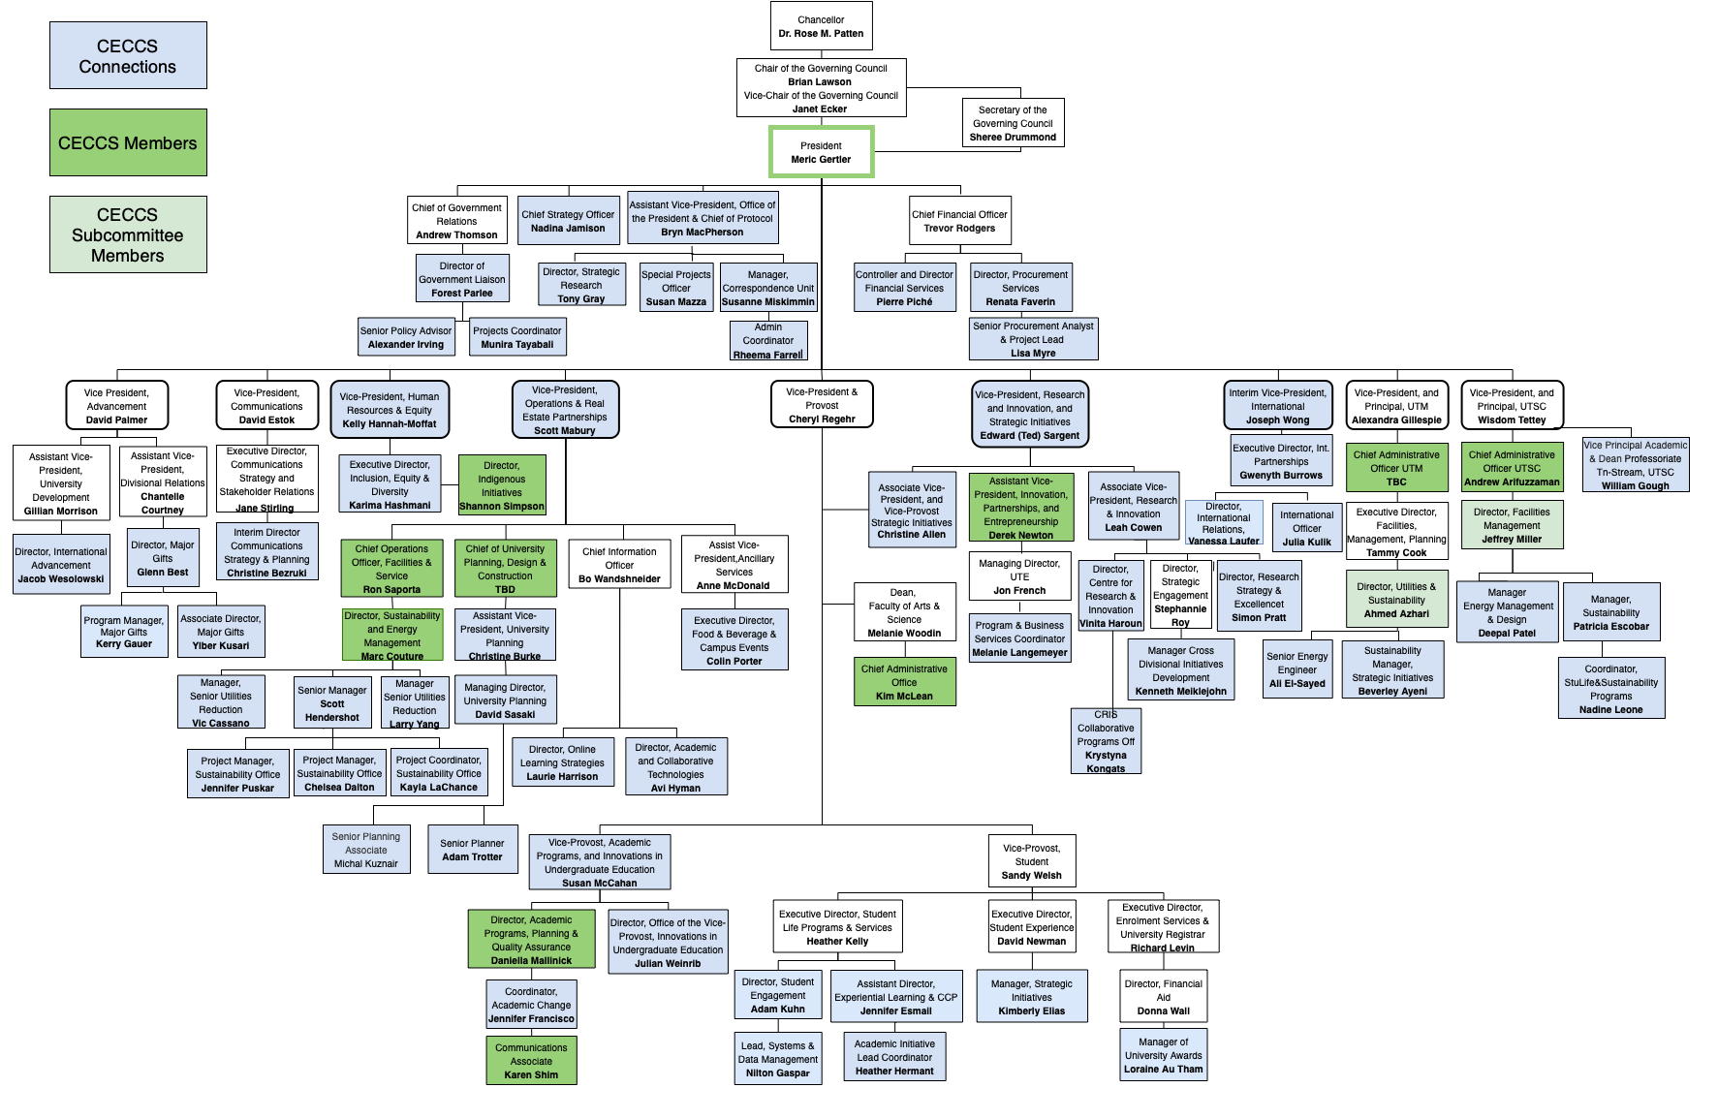
Embedding Sustainability at U of T
2. Infusing sustainability in HE
As of Nov 2021:
CECCS has engaged all 9 Vice-Presidential offices and 9 of 18 divisions
CECCS takes an enabling role: celebrating, initiating, piloting, embedding

Slide 17

Urban Climate Action Project (UCAP)
3. Scaling Up
Actionable Knowledge
Campus as a living lab
Urban transition labs
Evaluations of programs and processes
Databases and models
Analysis of transition processes
Student internships with city
Community engagement research
Convening function (events, activities, meetings, etc.)
Network learnings and jurisdictional scans
Many cities have adopted climate targets that will require “transformational changes in how we live, work, commute and build” (City of Toronto, 2020)
Create a city-university collaborative
Focus on contributing actionable knowledge to help the City of Toronto achieve it TransformTO climate action goals and targets
Toronto node of UCAN network:
PROJECT: UC3 Cities Climate Action Network (UCAN)
CHAMPIONS: University of Arizona, University of British Columbia, Drexel U, University of Toronto

Slide 18
3. Scaling Up
The Role of the University in contributing to scaling up
RESEARCH | ENGAGE & CONVENE | INNOVATE & EXPERIMENT | EVALUATE | BUILD CAPACITY
R1: develop collaborative interdisciplinary research R2: identify best practices around the world R3: scan of relevant local and global trends R4: scan funding mechanisms | EC1: Convene partner events and activities EC2: Share operational practices EC3: Jointly develop community engagement programs EC4: Grow and strengthen strategic partnerships | IET1: Turn campuses into living labs and testbeds IET2: Set up urban transitions labs in city neighbourhoods, IE3: Jointly develop databases & models IE4: Share new approaches for problem solving (e.g., multi-solving) | E1: Evaluate city programs and processes. E2: Embody and enhance reflexive practice to create new knowledge and mindsets | BC1: Engage graduate and undergraduate students internships and RAs. BC2: Help to grow the UCAN network.

Slide 19
In conclusion . . .
Institutional culture change at universities is needed to effectively address issues like sustainability and climate change
Ultimate goal is normalization of sustainability through academic/operational partnerships and institutional embedding
There is also a major opportunity to strengthen and deepen relationships with non-academic partners
Such projects offer a way for the university to contribute to scaling sustainability in the community

Slide 20
Let’s Make it Happen!

